Slide 1
ConsumIt Iteration 1
Calvin McLain
Joshua Burton
Cory Bridewell

Slide 2
Project Goal
To create a user friendly GUI to save consumable content to view later and identify average amount of time to consume content to the ConsumIt community.

Slide 3
Use Cases
Create consumable
Consume consumable
List consumable
Share consumable
Related consumable
Follow consumable

Slide 4
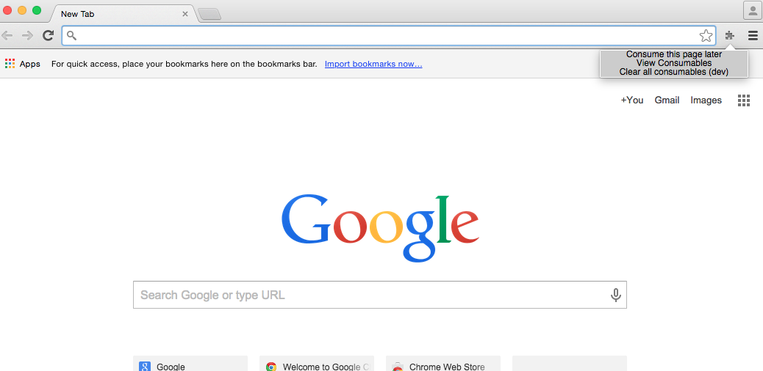

Slide 5
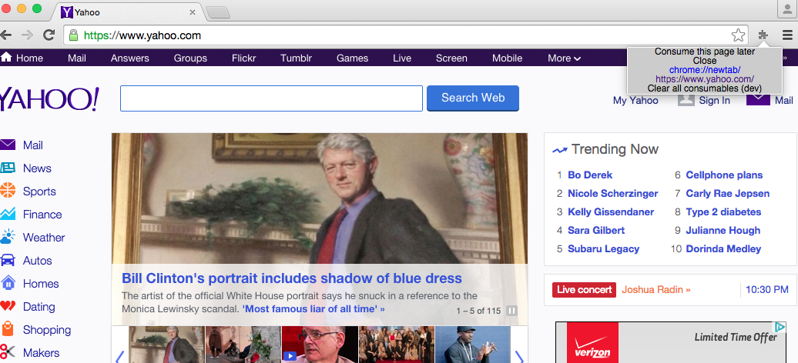

Slide 6
